Slide 1
Team - 2
Project 30 – Air Quality Analysis

Slide 2

Our Globe…

Slide 3
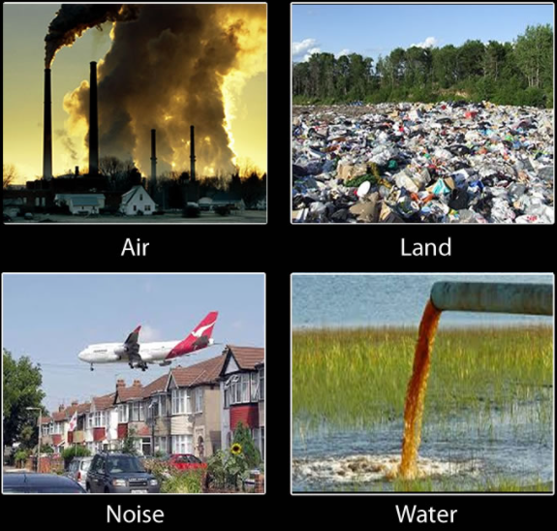
Pollution
Addition of any harmful substances or form of energy to the environment at a rate faster than it can be dispersed into earths atmosphere.
Types of pollution

Slide 4
Air pollution
Air pollution is the contamination of air due to the presence of substances in the atmosphere.
Some different types of air pollutants are ammonia, carbon monoxide, sulfur dioxide, nitrous oxides, methane, carbon dioxide and chlorofluorocarbons which gets emitted from the industries, homes.

Slide 5
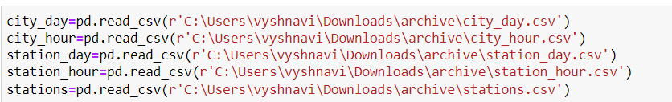
Air Quality Analysis
Loaded datasets
Imported libraries
import numpy as np
import pandas as pd
import matplotlib.pyplot as plt
import seaborn as sns

Slide 6
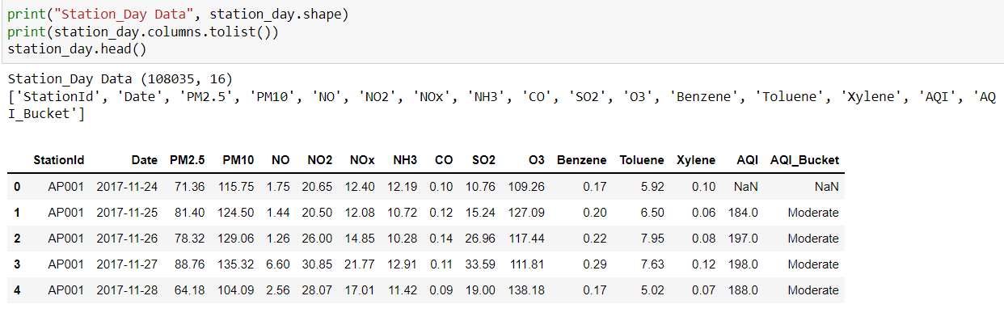
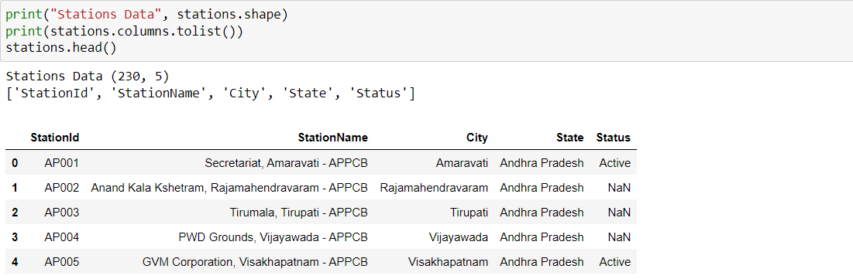
Data description

Slide 7
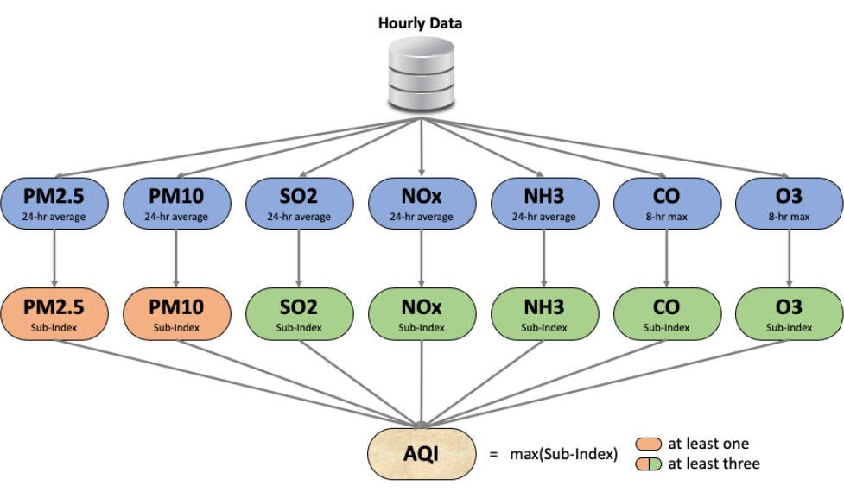
AQI
The AQI calculation uses 7 measures: PM2.5, PM10, SO2, NOx, NH3, CO and O3 by converting into a Sub-Index based on pre-defined groups.

Slide 8
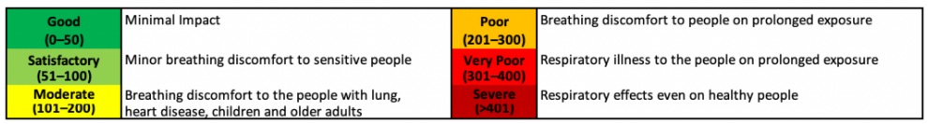
AQI ranges
The final AQI is the maximum Sub-Index among the available sub-indices with the condition that at least one of PM2.5 and PM10 should be available and at least three out of the seven should be available.

Slide 9
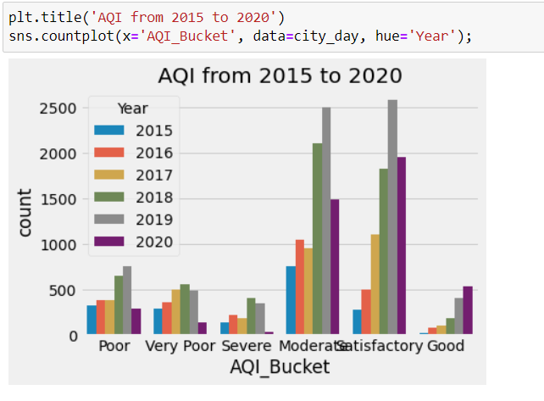
AQI analysis

Slide 10
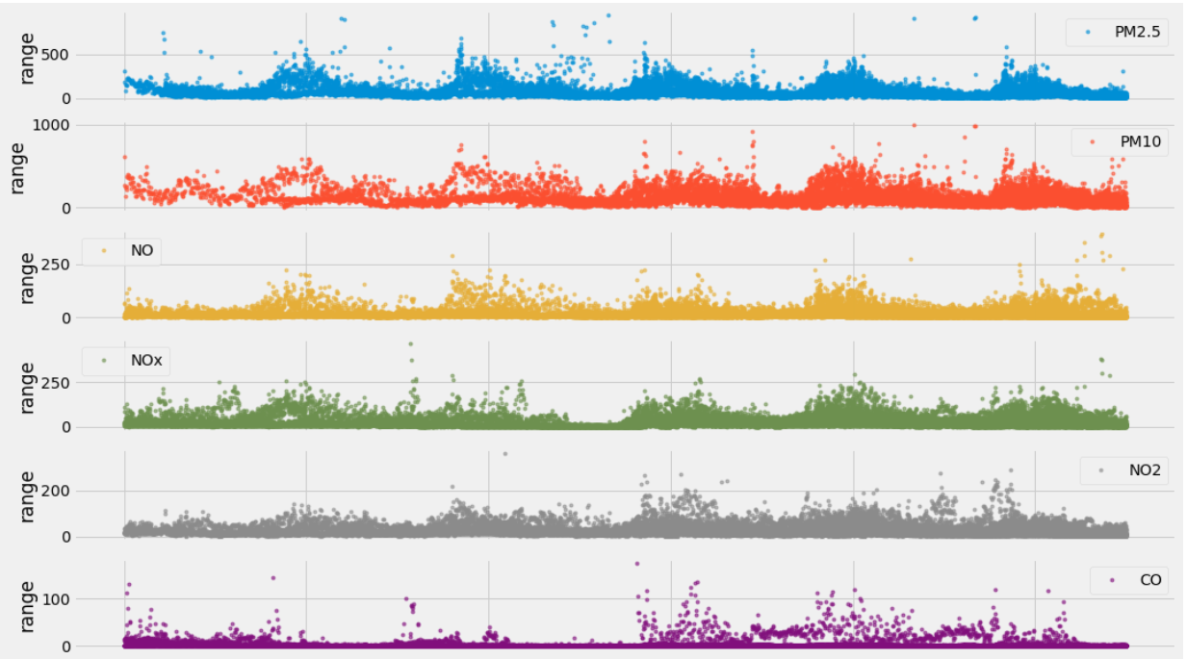
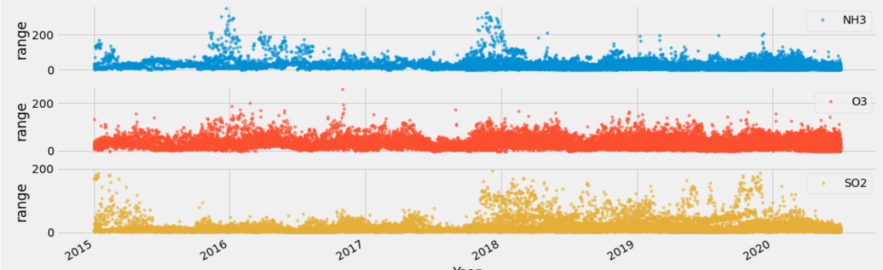
Pollutants range

Slide 11
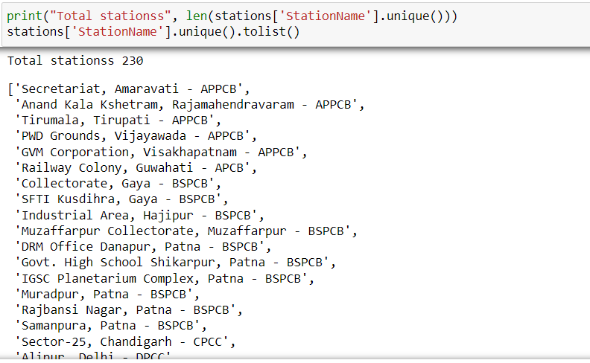
Total stations…

Slide 12
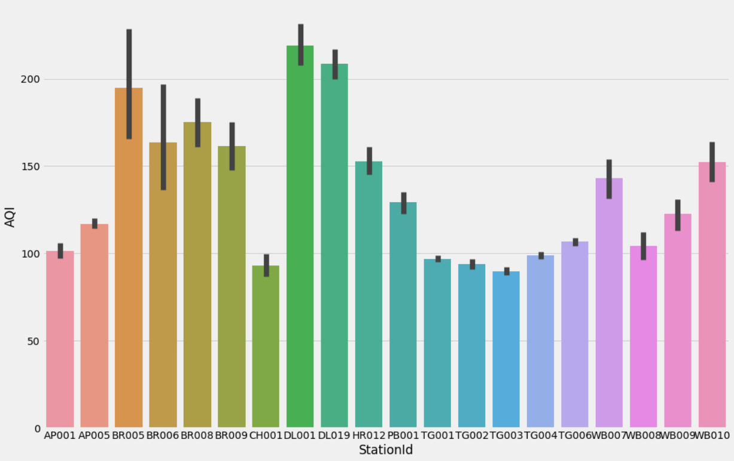
Stations AQI analysis

Slide 13
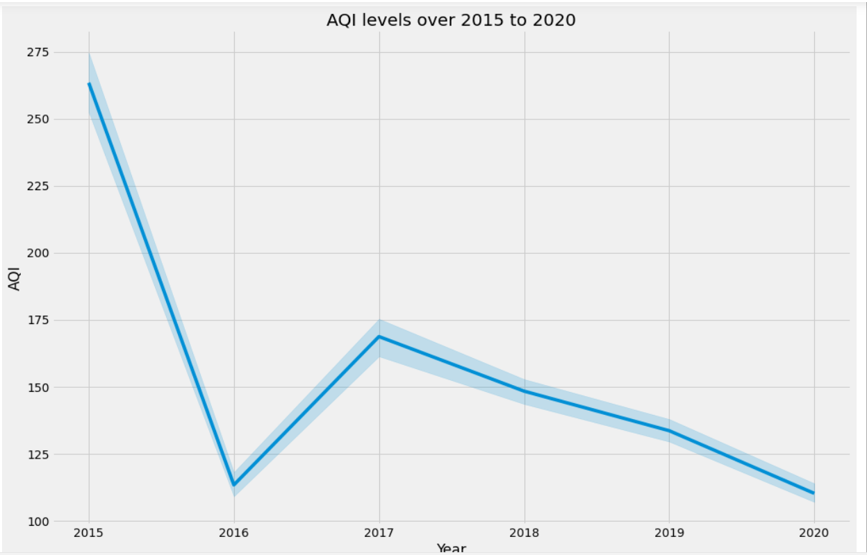
AQI ranges from the stations over years
Minimum and maximum range of AQI : 16.0 and 692.0

Slide 14
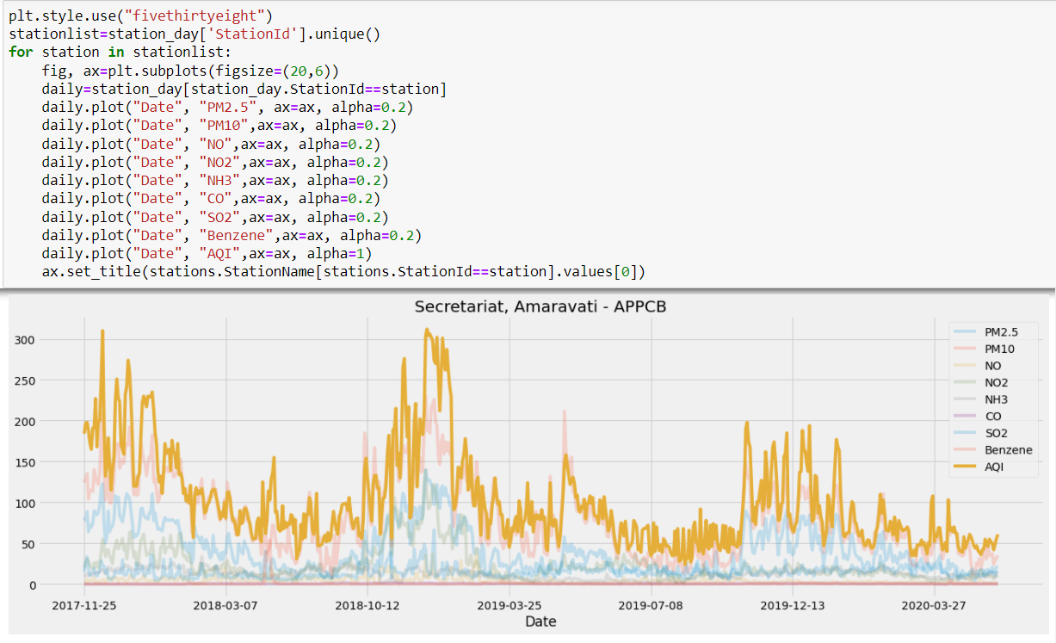
Decima Mono representation

Slide 15
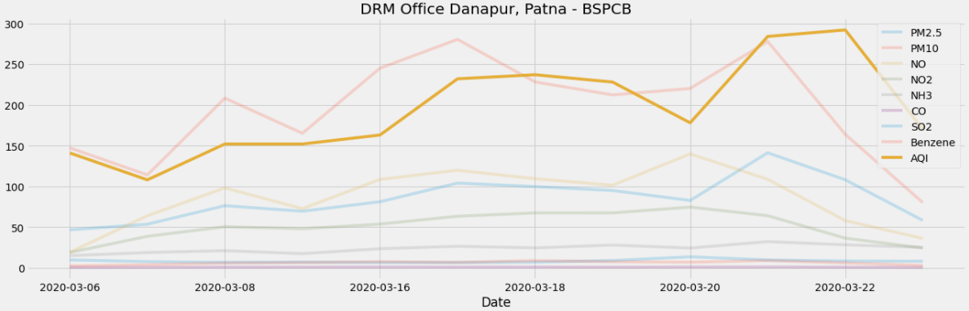
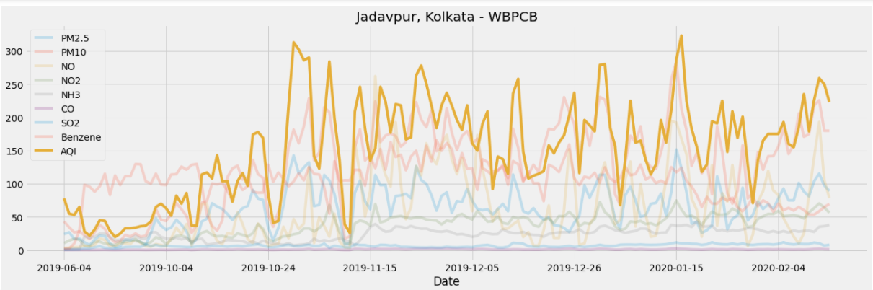
Most effected stations
From fivethirthyeight plotting we can compare AQI for every considered station.
The most effected area is danapur and next to it is jadavpur which are having greater AQI in 2020.

Slide 16
THANK YOU

